Slide 1
Blockchain for Digital Government
Presented By:
Prashant K Sachan | 17103061
Rajnish Kumar| 17103069
Rupinderjeet | 1710307
Harpreet Singh | 171030asf

Slide 2
Table Of Content
Introduction
Key Features of Project
Understanding the problem
General Flow of System
Why Blockchain ?
References
Blockchain and digital Government
Project Objective
Case Study

Slide 3


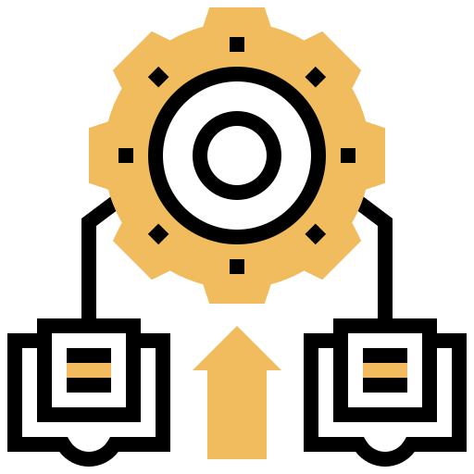
Introduction
With the help of blockchain government could become a trusted partner and reinvent existing processes to enable more collaboration across agencies and with citizens.
Blockchains could provide a consistent, transparent and open view of activities, information and decisions, fueling the open innovation and reinvention of government services. These include
Co-created services
Integrated services
Self-governed services
Notes:
1 Disparate, top-down service delivery processes could be replaced by a seamless process that empowers citizens and government to co-create the types of services citizens want and need.
2 Centralized systems and disparate data silos could be replaced by a single replicated database that provides a secure and immutable version of the truth, open to use by all ecosystems stakeholders.
3 Centralized government control could be replaced by self regulated service delivery ecosystems.

Slide 4
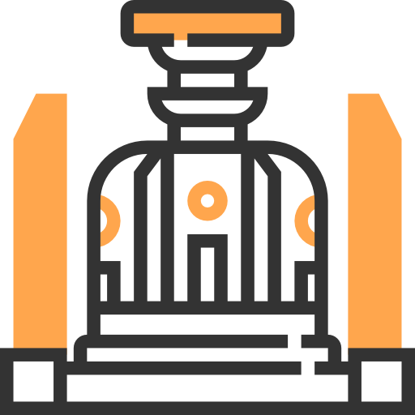

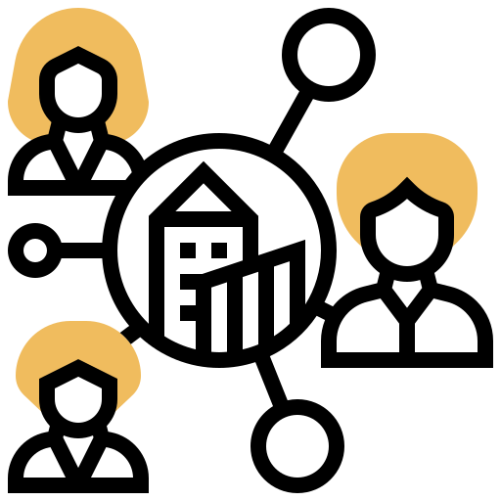
Understanding the problem
DEMOCRACY IS NOT PERFECT
NON TRANSPARENT INFRASTRUCTURE
CENTRALISED SYSTEM
Notes:
People at the center of the system have too much power.
The system is inherently not transparent and no one in the public gets to know what is happening at the center.

Slide 5

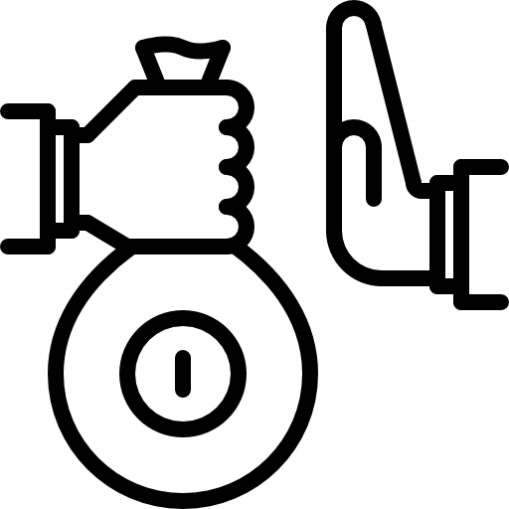

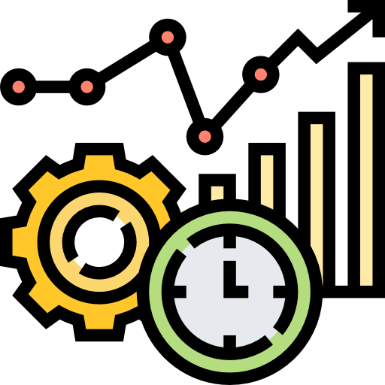

Why Blockchain?
Decentralised Technology
Does not have a single governing body
Cannot be Corrupted
Every node has a copy of the digital ledger
Distributed Ledger
The ledger is maintained by all the nodes,
Increased Efficiency
Offers a faster settlement.
No one can change the characteristics.
Enhanced Security
Notes:
Blockchain is a decentralised solution to digitalize the current government monetary distribution system.
It does not leave all the power and control in the hands of some few individuals.
It is implemented in a peer to peer network. Each node in the network or the system has a copy of the whole ledger, that is, the blockchain.
Whenever any new transaction takes place, it is recorded as a new block, which is updated into the chain on every node.
And this feature helps in curbing corruption and increasing the security.
As modifying even a single block or even a little amount data in the block invalidates the whole chain ahead of it as if any block is modified, it is no more the same block, it is a whole new block. So if any wrong modifications are done knowingly or unknowingly by mistake, they are known to every one on the system and not just ignored as in today’s conventional system.
Also, the transactions occur faster as validating a transaction is no more the responsibility of a single individual, all the nodes, which are the miners can do it.
Next, Project Objective will be explained.

Slide 6
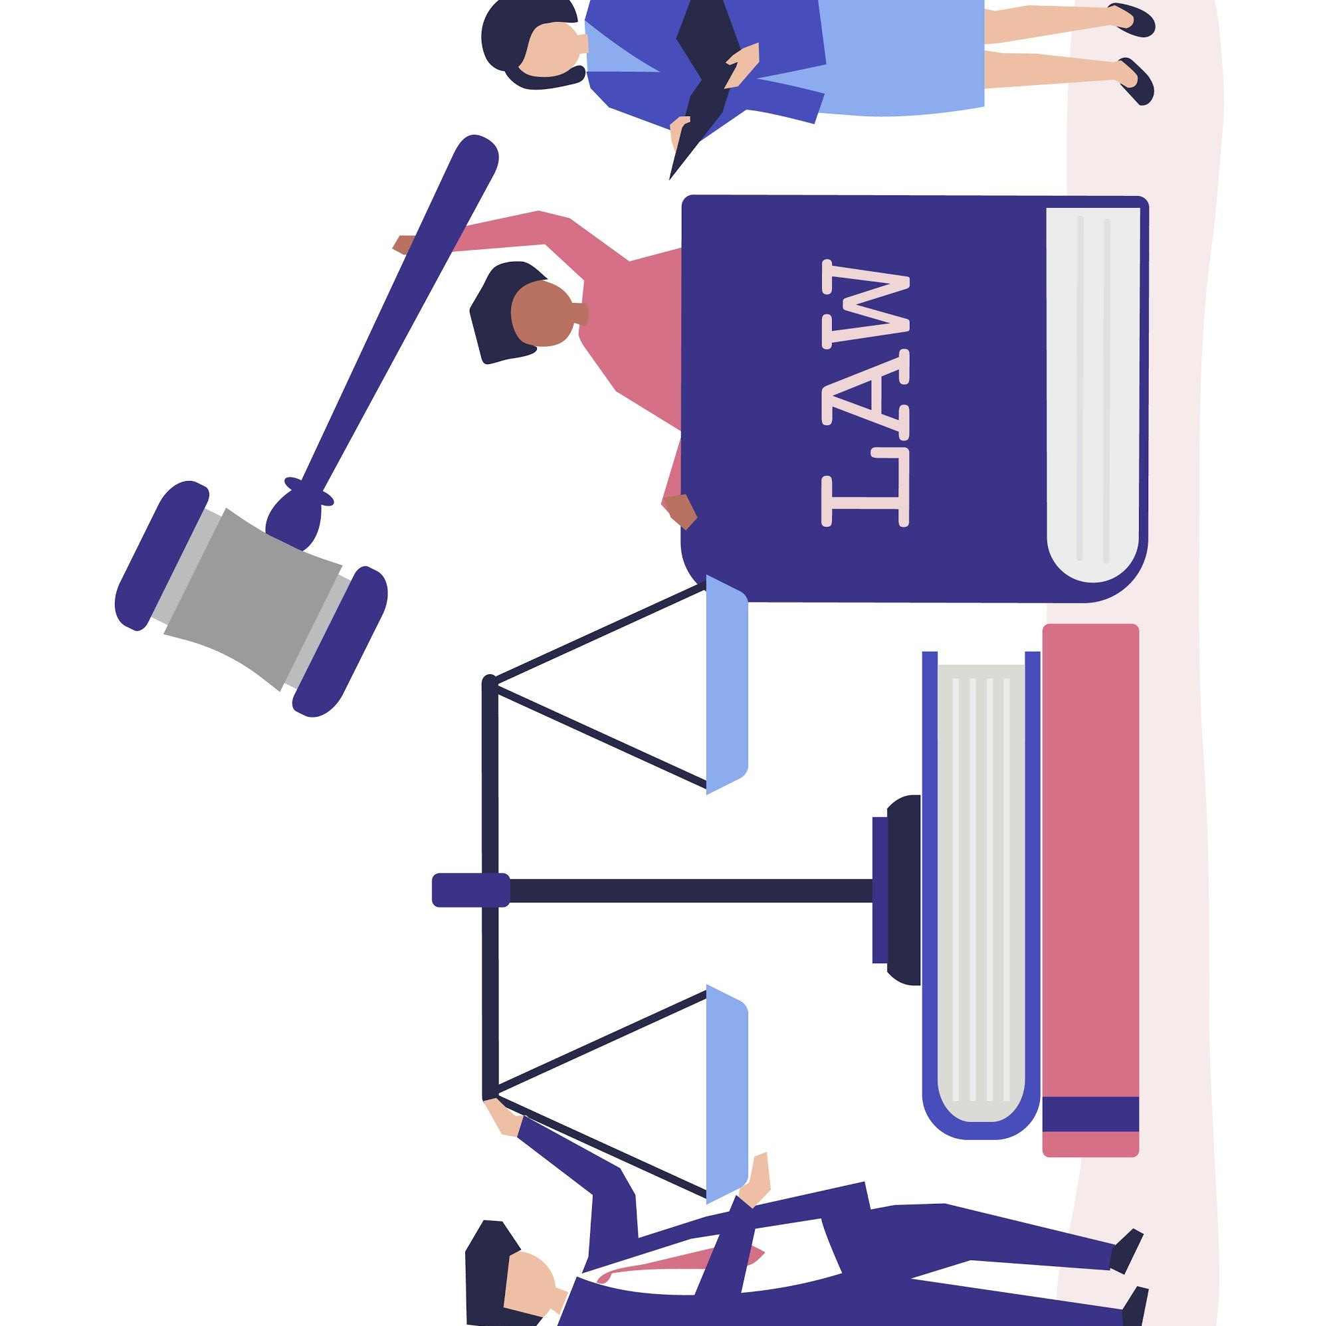

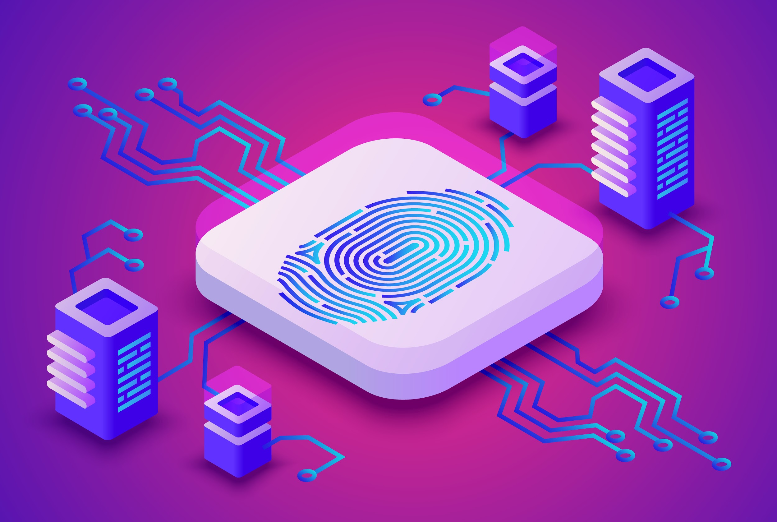
Project Objective
Blockchain technology has a huge potential to iron out glitches and improve efficiency in India’s Government System.
With the help of this project we strive to improve the existing system. It can help us to increase transparency and curb corruption in the money flow through the various levels of the government from the top to the bottom of the distribution system.

Slide 7

Blockchain and digital governments
Reduced economic costs, time and complexity in inter-governmental and public private information exchanges that enhance the administrative function of governments.
Reduction of bureaucracy, discretionary power and corruption, induced by the use of distributed ledgers and programmable smart contracts.
Increased automation, transparency, auditability and accountability of information in governmental registries for the benefit of citizens.
Increased trust of citizens and companies in governmental processes and recordkeeping driven by the use of algorithms which are no longer under the sole control of government.

Slide 8

Case Study
Project | Advantage | Shortcomings | Year of Implementation
Exonum land title registry – Georgia | Citizens can cross check if the land title is legit. Reduction of the land title registration and verification time. Increased security and reliability of digital certificates. | Chances of locking in the Bitcoin blockchain. | Project: 2016 Source: https://ec.europa.eu/isa2/actions/elise_en
Pension infrastructure - the Netherlands | Smart contracts are used to determine the rules for building up a pension balance for a citizen. They will also prescribe rules of who can view, change, and use the data. | N/A | Project: 2019 Source: https://ec.europa.eu/isa2/actions/elise_en

Slide 9
Case Study
Project | Advantage | Shortcomings | Year of Implementation
Infrachain governance framework - Luxemburg | Increased reliability and resilience. Transparency and flexibility. Identity and privacy protection Convenient storage and sharing, quick verification. | Membership cost: €1-6 thousand per year | Project: Nov, 2016 Source: https://ec.europa.eu/isa2/actions/elise_en
Blockcerts academic credentials Malta | Greater control over his educational achievements and certificates. Self-sovereignty. The permission to share is placed at the citizens. Identity and privacy protection.. | The current use case is limited to academic, yet the system itself could be extended to include multiple types of citizen records. | Project: 2017 Source: https://ec.europa.eu/isa2/actions/elise_en

Slide 10
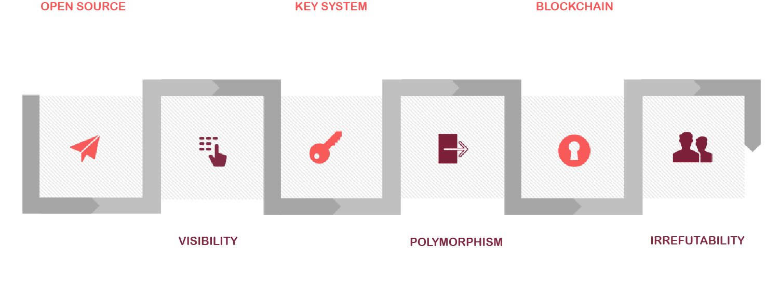
Key Features of this Project

Slide 11


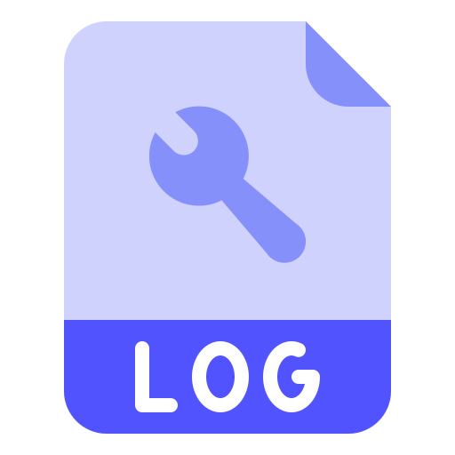
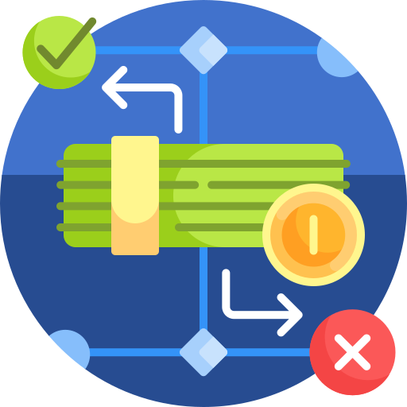


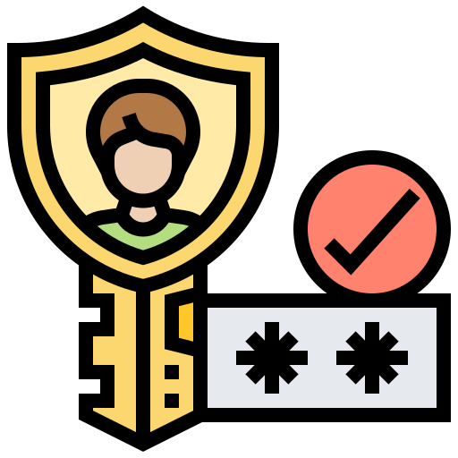
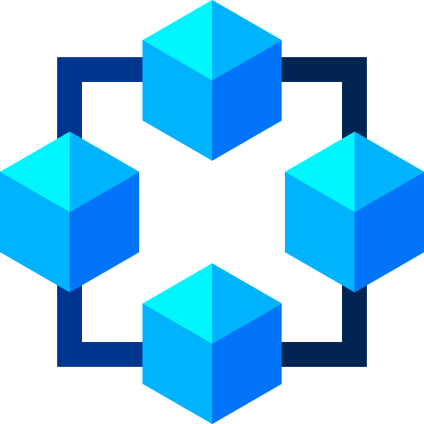
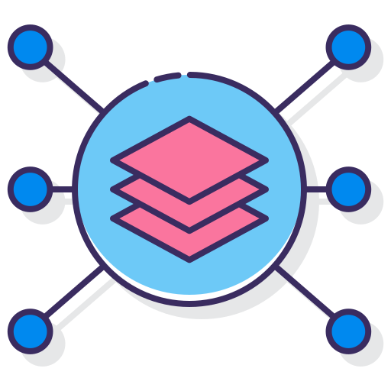
General Flow of the System
CONTROLLING AUTHORITY
REGISTRATION LOG
PUBLIC PORTAL
GROUND LEVEL OFFICES
CITIZEN
GOVERNMENT SCHEME
Registration
Authentication
Blockchain 1
Blockchain 2
Oversight
Deployment
Citizens will register in the system
The authority will authenticate the citizen and Provide an Identification No.
Blockchain of all the user registered in the system.
Blockchain of all the people availing the service / benefitting from the scheme.
People can provide oversight and ensure a transparent workflow.
The intended person will get the benefits.
Notes:
This slide displays the General Flow of the System.
Every user has to register in to the system, it can be citizen who just wants to pay taxes through or a government official who has to make the sanctions to an upcoming project or a scheme or the departments..or it can be anyone who wants to query information about the government projects from the system, anyone who wants to see where is the government spending its budget actually.
Every user will be authorized and provided an identification number, which can be used to login later.
All the registration logs are also saved in the system in blockchains.
Another Blockchain is that of the transactions which are occurring, that contain information about the flow of money from the top to the ground level offices, where that money will be actually used in doing stuff, where it is actually deployed for financing a government scheme or given to the citizens under a government scheme like pensions.
All these transactions can be overseen by the people to ensure a transparent monetary flow.

Slide 12
References
C. P. Jagrat and J. Channegowda, "A Survey of Blockchain Based Government Infrastructure Information," 2020 International Conference on Mainstreaming Block Chain Implementation (ICOMBI), Bengaluru, India, 2020, pp. 1-5, doi: 10.23919/ICOMBI48604.2020.9203152.
https://ec.europa.eu/jrc
A. Mohite and A. Acharya, "Blockchain for government fund tracking using Hyperledger," 2018 International Conference on Computational Techniques, Electronics and Mechanical Systems (CTEMS), Belgaum, India, 2018, pp. 231-234, doi: 10.1109/CTEMS.2018.8769200.

Slide 13
THANK
YOU

